Slide 1
Introduction to IOT
G.Mallikarjuna Rao

Slide 2
Syllabus
Unit III
Introduction To Internet of Things: Introduction, Physical Design of IoT, Logical Design of IoT, IoT enabling Technologies, IoT Levels and Deployment Templates
Domain Specific IoTs: Introduction, Home Automation, Smart Cities, Environment, Energy, Retail, Logistics, Agriculture, Industry, Health and LifeStyle
UNIT IV
IoT Systems- Logical Design Using Python: Introduction, Installing python, Python data types and data structures, Control Flow, Functions, Modules, Packages, File Handling, Date/ Time operations, Classes, Python Packages of Interest for IoT.
IoT Physical Devices And End Points: IoT Device, Exemplary Device: Raspberry Pi, About the board, Linux on Raspberry Pi, Raspberry Pi Interfaces, Programming Raspberry Pi with Python

Slide 3
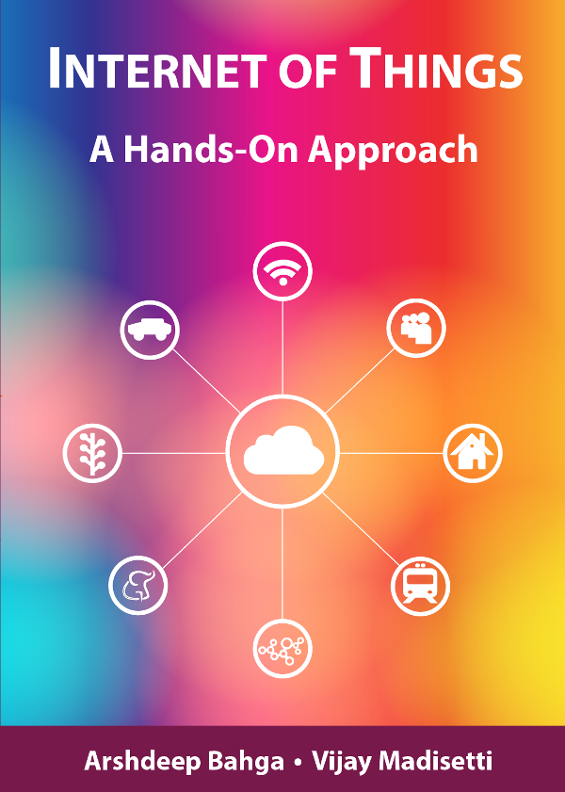
Chapter 1
Introduction to IoT
Book website: http://www.internet-of-things-book.com
Bahga & Madisetti, © 2015

Slide 4
DOMAIN SPECIFIC IoTs
Home Automation:
Smart Lighting: helps in saving energy by adapting the lighting to the ambient conditions and switching on/off or diming the light whenneeded.
Smart Appliances: make the management easier and also provide status information to the users remotely.
Intrusion Detection: use security cameras and sensors(PIR sensors and door sensors) to detect intrusion and raise alerts. Alerts can be in the form of SMS or email sent to the user.
Smoke/Gas Detectors: Smoke detectors are installed in homes and buildings to detect smoke that is typically an early sign of fire. Alerts raised by smoke detectors can be in the form of signals to a fire alarm system. Gas detectors can detect the presence of harmful gases such as CO, LPGetc.,

Slide 5
DOMAIN SPECIFIC IoTs
2) Cities:
Smart Parking: make the search for parking space easier and convenient for drivers. Smart parking are powered by IoT systems that detect the no. of empty parking slots and send information over internet to smart application back ends.
Smart Lighting: for roads, parks and buildings can help in saving energy.
Smart Roads: Equipped with sensors can provide information on driving condition, travel time estimating and alert in case of poor driving conditions, traffic condition and accidents.
Structural Health Monitoring: uses a network of sensors to monitor the vibration levels in the structures such as bridges and buildings.
Surveillance: The video feeds from surveillance cameras can be aggregated in cloud based scalable storage solution.
Emergency Response: IoT systems for fire detection, gas and water leakage detection can help in generating alerts and minimizing their effects on the critical infrastructures.

Slide 6
DOMAIN SPECIFIC IoTs
3) Environment:
Weather Monitoring: Systems collect data from a no. of sensors attached and send the data to cloud based applications and storage back ends. The data collected in cloud can then be analyzed and visualized by cloud based applications.
Air Pollution Monitoring: System can monitor emission of harmful gases(CO2, CO, NO, NO2 etc.,) by factories and automobiles using gaseous and meteorological sensors. The collected data can be analyzed to make informed decisions on pollutions control approaches.
Noise Pollution Monitoring: Due to growing urban development, noise levels in cities have increased and even become alarmingly high in some cities.

Slide 7
IoT based noise pollution monitoring systems use a no. of noise monitoring systems that are deployed at different places in a city. The data on noise levels from the station is collected on servers or in the cloud. The collected data is then aggregated to generate noise maps.
Forest Fire Detection: Forest fire can cause damage to natural resources, property and human life. Early detection of forest fire can help in minimizing damage.
River Flood Detection: River floods can cause damage to natural and human resources and human life. Early warnings of floods can be given by monitoring the water level and flow rate. IoT based river flood monitoring system uses a no. of sensor nodes that monitor the water level and flow rate sensors.

Slide 8
4) Energy:
Smart Grids: is a data communication network integrated with the electrical grids that collects and analyze data captured in near-real-time about power transmission, distribution and consumption. Smart grid technology provides predictive information and recommendations to utilities, their suppliers, and their customers on how best to manage power. By using IoT based sensing and measurement technologies, the health of equipment and integrity of the grid can be evaluated.
Renewable Energy Systems: IoT based systems integrated with the transformers at the point of interconnection measure the electrical variables and how much power is fed into the grid. For wind energy systems, closed-loop controls can be used to regulate the voltage at point of interconnection which coordinate wind turbine outputs and provides power support.
Prognostics: In systems such as power grids, real-time information is collected using specialized electrical sensors called Phasor Measurment Units(PMUs) at the substations. The information received from PMUs must be monitored in real-time for estimating the state of the system and for predicting failures

Slide 9
5) Retail:
Inventory Management: IoT systems enable remote monitoring of inventory using data collected by RFID readers.
Smart Payments: Solutions such as contact-less payments powered by technologies such as Near Field Communication(NFC) and Bluetooth.
Smart Vending Machines: Sensors in a smart vending machines monitors its operations and send the data to cloud which can be used for predictive maintenance.

Slide 10
6) Logistics:
Route generation & scheduling: IoT based system backed by cloud can provide first response to the route generation queries and can be scaled upto serve a large transportation network.
Fleet Tracking: Use GPS to track locations of vehicles in real-time.
Shipment Monitoring: IoT based shipment monitoring systems use sensors such as temp, humidity, to monitor the conditions and send data to cloud, where it can be analyzed to detect food spoilage.
Remote Vehicle Diagnostics: Systems use on-board IoT devices for collecting data on Vehicle operations(speed, RPMetc.,) and status of various vehicle subsystems.

Slide 11
7) Agriculture:
Smart Irrigation: to determine moisture amount in soil.
Green House Control: to improve productivity.
8) Industry:
Machine diagnosis and prognosis
Indoor Air Quality Monitoring
9) Health and LifeStyle:
Health & Fitness Monitoring
Wearable Electronics

Slide 12
Any Quires…?
Thank You
IOT Protocol features →
Notes:
An objective questioner is proposed to know your under standing on this class. Thank you

Slide 13
HyperText Transfer Protocol (HTTP)
Clients and servers communicate using the HyperText Transfer Protocol (HTTP)
Client and server establish TCP connection
Client requests content
Server responds with requested content
Client and server close connection (usually)
HTTP request
Web
client
(browser)
Web
server
HTTP response
(content)

Slide 14
Web Content
Web servers return content to clients
a sequence of bytes with an associated MIME (Multipurpose Internet Mail Extensions) type
Example MIME types
text/html HTML document
text/plain Unformatted text
application/postscript Postscript document
image/gif Binary image encoded in GIF format
image/jpeg Binary image encoded in JPEG format

Slide 15
Static & Dynamic Content
The content returned in HTTP responses can be either static or dynamic
Static content: content stored in files and retrieved in response to an HTTP request
Examples: HTML files, images, audio clips
Dynamic content: content produced on-the-fly in response to an HTTP request
Example: content produced by a program executed by the server on behalf of the client
Bottom line: all web content is associated with a file that is managed by the server

Slide 16
URLs
Each file managed by a server has a unique name called a URL (Universal Resource Locator)
URLs for static content:
http://www.cse.nd.edu:80/index.html
http://www.cse.nd.edu/index.html
http://www.cse.nd.edu
Identifies a file called index.html, managed by a web server at www.cse.nd.edu that is listening on port 80
URLs for dynamic content:
http://www.cse.nd.edu:8000/cgi-bin/adder?15000&213
Identifies an executable file called adder, managed by a web server at www.cse.nd.edu that is listening on port 8000, that should be called with two argument strings: 15000 and 213

Slide 17
Anatomy of an HTTP Transaction
unix> telnet www.aol.com 80 Client: open connection to server
Trying 205.188.146.23... Telnet prints 3 lines to the terminal
Connected to aol.com.
Escape character is '^]'.
GET / HTTP/1.1 Client: request line
host: www.aol.com Client: required HTTP/1.1 HOST header
Client: empty line terminates headers.
HTTP/1.0 200 OK Server: response line
MIME-Version: 1.0 Server: followed by five response headers
Date: Mon, 08 Jan 2001 04:59:42 GMT
Server: NaviServer/2.0 AOLserver/2.3.3
Content-Type: text/html Server: expect HTML in the response body
Content-Length: 42092 Server: expect 42,092 bytes in the resp body
Server: empty line (“\r\n”) terminates hdrs
<html> Server: first HTML line in response body
... Server: 766 lines of HTML not shown.
</html> Server: last HTML line in response body
Connection closed by foreign host. Server: closes connection
unix> Client: closes connection and terminates

Slide 18
HTTP Requests
HTTP request is a request line, followed by zero or more request headers
Request line: <method> <uri> <version>
<version> is HTTP version of request (HTTP/1.0 or HTTP/1.1)
<uri> is typically URL for proxies, URL suffix for servers
<method> is either GET, POST, OPTIONS, HEAD, PUT, DELETE, or TRACE

Slide 19
HTTP Requests
HTTP methods:
GET: Retrieve static or dynamic content
Arguments for dynamic content are in URI
Workhorse method (99% of requests)
POST: Retrieve dynamic content
Arguments for dynamic content are in the request body
OPTIONS: Get server or file attributes
HEAD: Like GET but no data in response body
PUT: Write a file to the server
DELETE: Delete a file on the server
TRACE: Echo request in response body
Useful for debugging

Slide 20
HTTP Responses
HTTP response is a response line followed by zero or more response headers
Response line:
<version> <status code> <status msg>
<version> is HTTP version of the response
<status code> is numeric status
<status msg> is corresponding English text
200 OK Request was handled without error
403 Forbidden Server lacks permission to access file
404 Not found Server couldn’t find the file
Response headers: <header name>: <header data>
Provide additional information about response
Content-Type: MIME type of content in response body
Content-Length: Length of content in response body

Slide 21
REST
Representational State Transfer (REST)
A style of software architecture for distributed hypermedia systems such as the World Wide Web
A collection of network architecture principles which outline how resources are defined and addressed

Slide 22
REST & HTTP
The motivation for REST was to capture the characteristics of the Web which made the Web successful
URI Addressable resources
HTTP Protocol
Make a Request – Receive Response – Display Response
Exploits the use of the HTTP protocol beyond HTTP POST and HTTP GET
HTTP PUT, HTTP DELETE

Slide 23
REST
REST is not a standard
is an architectural style
But it uses several standards:
HTTP
URL
XML/HTML/GIF/JPEG/etc (Resource Representations)
text/xml, text/html, image/gif, image/jpeg, etc (Resource Types, MIME Types)

Slide 24
REST Main Concepts
Nouns (Resources) unconstrained i.e., http://example.com/employees/12345
REST
Verbs constrained i.e., GET
Representations constrained i.e., XML

Slide 25
Resources
The key abstraction of information in REST is a resource
A resource is a conceptual mapping to a set of entities
Any information that can be named can be a resource: a document or image, a temporal service (e.g., “today's weather in Berlin”), a collection of other resources, a non-virtual object (e.g., a person), etc.
Represented with a global identifier (URI in HTTP)
http://www.boeing.com/aircraft/747

Slide 26
Naming Resources
REST uses URI to identify resources
http://localhost/books/
http://localhost/books/ISBN-0011
http://localhost/books/ISBN-0011/authors
http://localhost/classes
http://localhost/classes/cs2650
http://localhost/classes/cs2650/students
As you traverse the path from more generic to more specific, you are navigating the data

Slide 27
Verbs
Represent the actions to be performed on resources
HTTP GET
HTTP POST
HTTP PUT
HTTP DELETE

Slide 28
HTTP GET
How clients ask for the information they seek
Issuing a GET request transfers the data from the server to the client in some representation
GET http://localhost/books
Retrieve all books
GET http://localhost/books/ISBN-0011021
Retrieve book identified with ISBN-0011021
GET http://localhost/books/ISBN-0011021/authors
Retrieve authors for book identified with ISBN-0011021

Slide 29
HTTP PUT & POST
HTTP POST creates a resource
HTTP PUT updates a resource
POST http://localhost/books/
Content: {title, authors[], …}
Creates a new book with given properties
PUT http://localhost/books/isbn-111
Content: {isbn, title, authors[], …}
Updates book identified by isbn-111 with submitted properties

Slide 30
Representations
How data is represented or returned to the client for presentation.
Two main formats:
JavaScript Object Notation (JSON)
XML
It is common to have multiple representations of the same data

Slide 31
Representations
XML
<COURSE>
<ID>CS2650</ID>
<NAME>Distributed Multimedia Software</NAME>
</COURSE>
JSON
{course
{id: CS2650}
{name: Distributed Multimedia Software}
}

Slide 32
CoAP
Constrained Application Protocol
REST-based web transfer protocol
manipulates Web resources using the same methods as HTTP: GET, PUT, POST, and DELETE
subset of HTTP functionality re-designed for low power embedded devices such as sensors (for IoT and M2M)

Slide 33
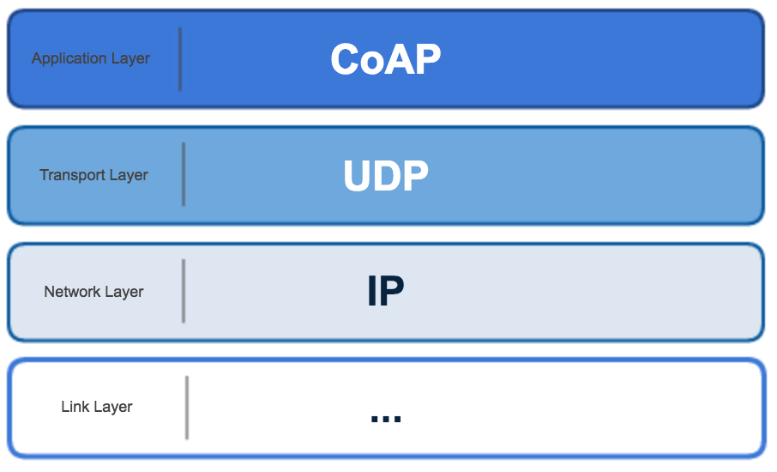
CoAP
TCP overhead is too high and its flow control is not appropriate for short-lived transactions
UDP has lower overhead and supports multicast

Slide 34
CoAP
Four message types:
Confirmable – requires an ACK
Non-confirmable – no ACK needed
Acknowledgement – ACKs a Confirmable
Reset - indicates a Confirmable message has been received but context is missing for processing

Slide 35
CoAP
CoAP provides reliability without using TCP as transport protocol
CoAP enables asynchronous communication
e.g., when CoAP server receives a request which it cannot handle immediately, it first ACKs the reception of the message and sends back the response in an off-line fashion
Also supports multicast and congestion control

Slide 36
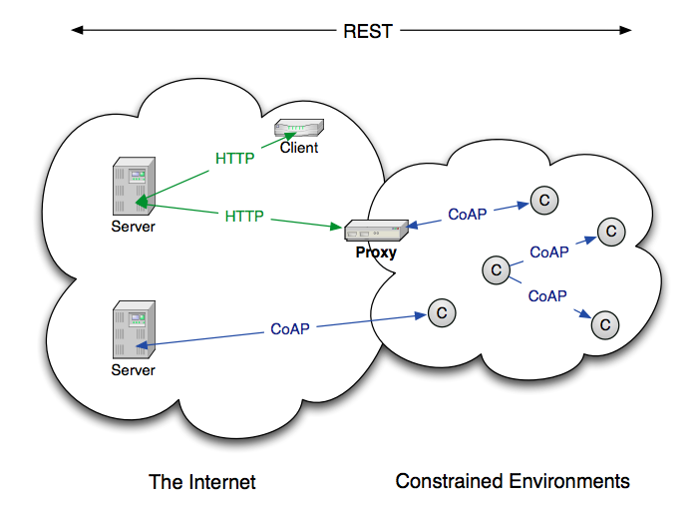
CoAP

Slide 37
What CoAP Is
CoAP is
A RESTful protocol
Both synchronous and asynchronous
For constrained devices and networks
Specialized for M2M applications
Easy to proxy to/from HTTP

Slide 38
MQTT
Message Queuing Telemetry Transport
In a nutshell, MQTT consist of three parts:
Broker
Subscribers
Publishers

Slide 39
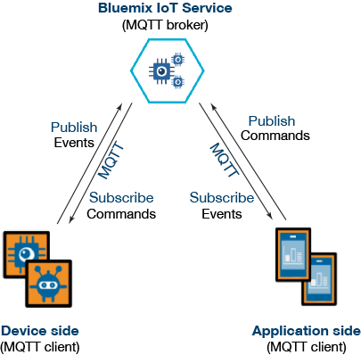
MQTT

Slide 40
MQTT
MQTT was invented by Andy Stanford-Clark (IBM) and Arlen Nipper (Arcom, now Cirrus Link) back in 1999, where their use case was to create a protocol for minimal battery loss and minimal bandwidth connecting oil pipelines over satellite connections. They specified the following goals, which the future protocol should have:
Simple to implement
Provide a Quality of Service Data Delivery
Lightweight and Bandwidth Efficient
Data Agnostic
Continuous Session Awareness

Slide 41
MQTT
Built for proprietary embedded systems; now shifting to IoT
You can send anything as a message; up to 256 MB
Built for unreliable networks
Enterprise scale implementations down to hobby projects
Decouples readers and writers
Message have a topic, quality of service, and retain status associated with them

Slide 42
Publish/Subscribe Concept
Decoupled in space and time:
The clients do not need each others
IP address and port (space) and
they do not need to be running at
the same time (time).
The broker’s IP and port must be
known by clients
Namespace hierarchy used for
topic filtering
It may be the case that a published
message is never consumed by any
Subscriber

Slide 43
MQTT: Example
Clients connect to a “Broker”
Clients subscribe to topics e.g.,
client.subscribe(‘toggleLight/1’)
client.subscribe(‘toggleLight/2’)
client.subscribe(‘toggleLight/3’)
Clients can publish messages to topics:
client.publish(‘toggleLight/1’, ‘toggle’);
client.publish(‘toggleLight/2’, ‘toggle’);
All clients receive all messages published to topics they subscribe to Messages can be anything
Text
Images
etc.

Slide 44
Node.js Example
var mqtt = require('mqtt');
var client = mqtt.createClient('<<PortNumber>>', 'm11.cloudmqtt.com', {
username: '<<UserName>>’,
password: '<<Password>>'
});
client.on('connect', function () { // When connected
// subscribe to a topic
client.subscribe('TEMPERATURE_READING', function () {
// when a message arrives, do something with it
client.on('message', function (topic, message, packet) {
console.log("Received '" + message + "' on '" + topic + "'");
});
});
// publish a message to a topic
client.publish('SET_TEMPERATURE', '24', function () {
console.log("Message is published");
});
});

Slide 45
Topics
Each published data specifies a topic
Each subscriber subscribed to that topic will receive it
Topic format:
separator
/home/rooms/kitchen/temperature
sub-topic
sub-topic
sub-topic
sub-topic

Slide 46
Durable/Transient Subscriptions
Subscriptions
Durable
If the subscriber disconnect messages are buffered at the broker and delivered upon reconnection
Non-durable
Connection lifetime gives subscription lifetime
M1
M2
M3
M4
M5
M6
Subscription
Durable
Connection
Connected
Connected

Slide 47
State Retention
Publications
Retained (“persistent” message)
The subscriber upon first connection receives the last good publication (i.e., does not have to wait for new publication)
One flag set both in the publish packet to the broker and in the published packet to the subscribers
Only the most recent persistent message is stored and distributed

Slide 48
Session Aware
Last Will and Testament (LWT) – topic published upon disconnecting a connection
Any client can register a LWT
Anybody subscribing to the LWT topic will know when a certain device (that registered a LWT) disconnected

Slide 49
Protocol Stack
Application
MQTT
SSL
optional
TCP
IP
TCP/IP Port: 1883
When running over SSL, TCP/IP port 8883
SSL: Secure Socket Layer (encryption)

Slide 50
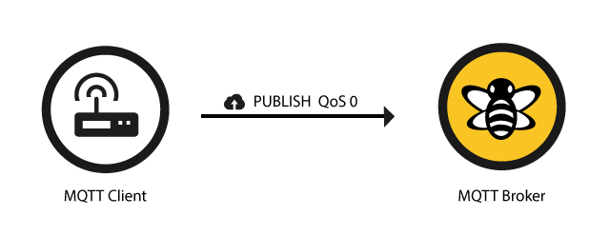
Publishing “QoS” (Reliability)
0 – unreliable (aka “at most once”)
OK for continuous streams, least overhead (1 message)
“Fire and forget”
TCP will still provide reliability

Slide 51

Publishing “QoS” (Reliability)
1 – delivery “at least once” (duplicates possible)
Used for alarms – more overhead (2 messages)
Contains message ID (to match with ACKed message)

Slide 52
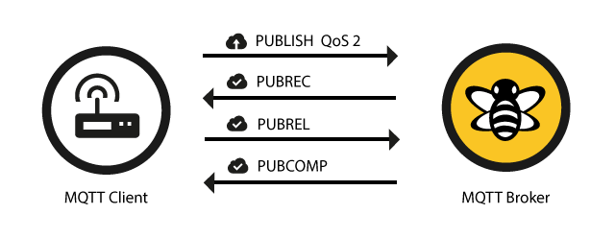
Publishing “QoS” (Reliability)
2 – delivery “exactly once”
Utmost reliability is important – most overhead (4 messages) and slowest

Slide 53
Publishing “QoS” (Reliability)
Reliability maintained even if the TCP connection breaks (intermittent connections)
Separate QoS for publishing and for subscribing

Slide 54
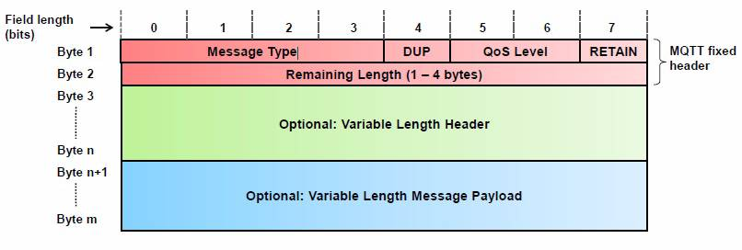
MQTT Message Format
Shortest Message is Two Bytes

Slide 55
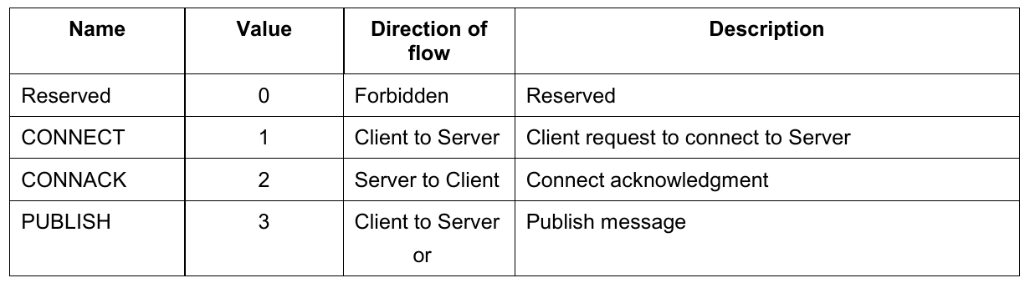
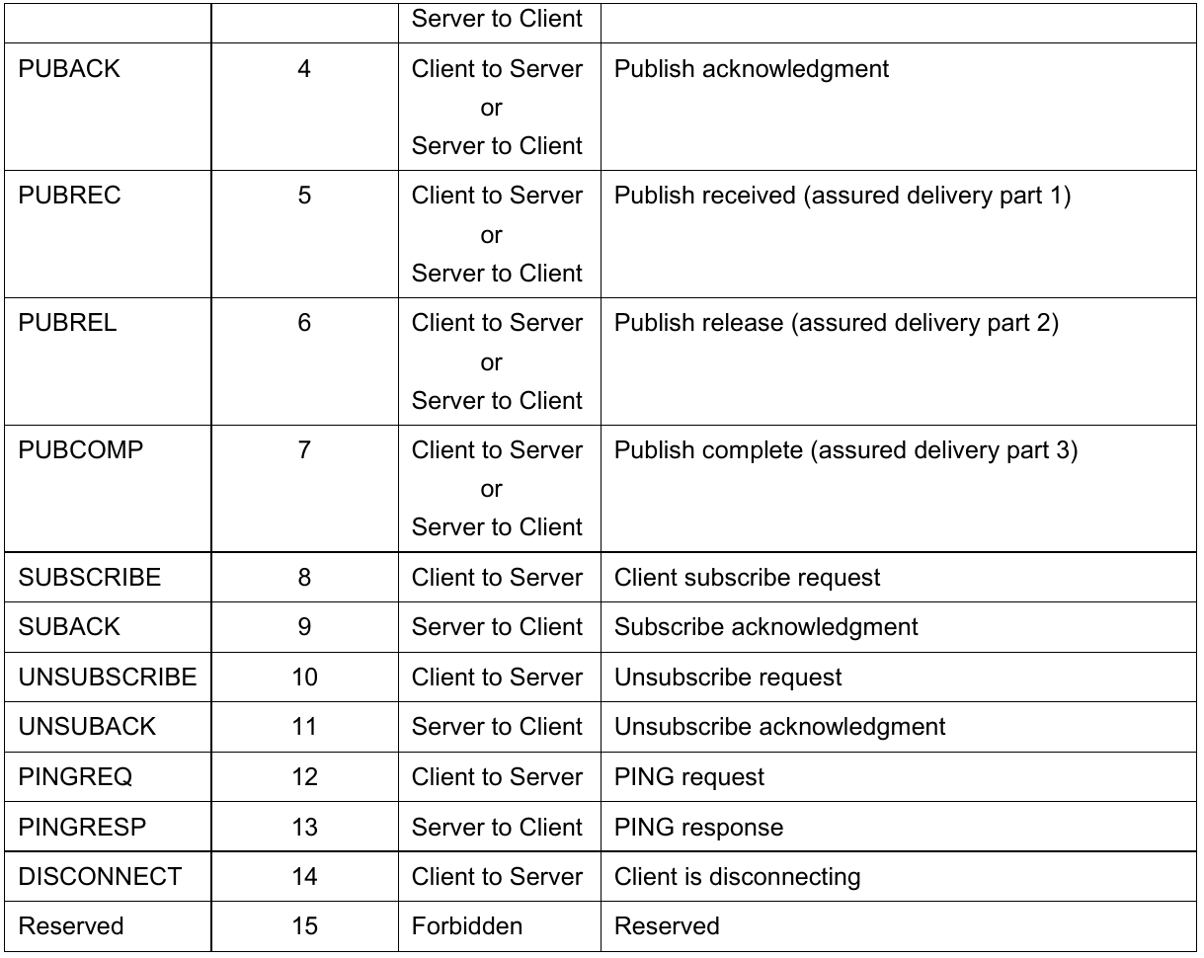
Message Types

Slide 56
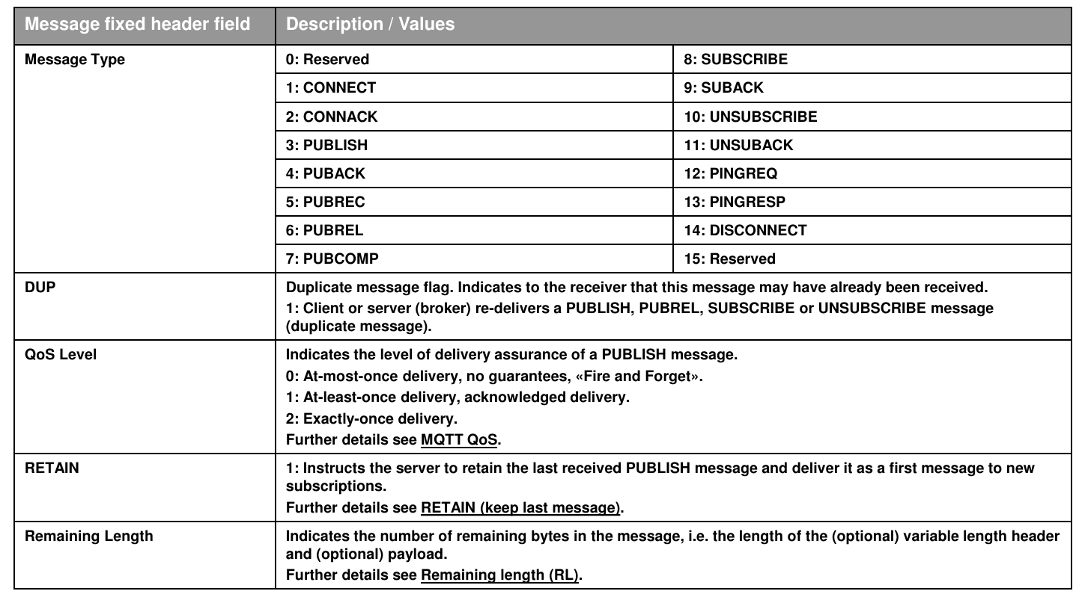
Message Types

Slide 57
Comparison CoAP & MQTT
Both used in IoT
CoAP:
one-to-one communication
UDP/IP
unreliable
lightweight and easy to implement
MQTT:
many-to-many communication
TCP/IP
focus on message delivery; reliable
higher overheads (protocol data, processing costs)

